Slide 1
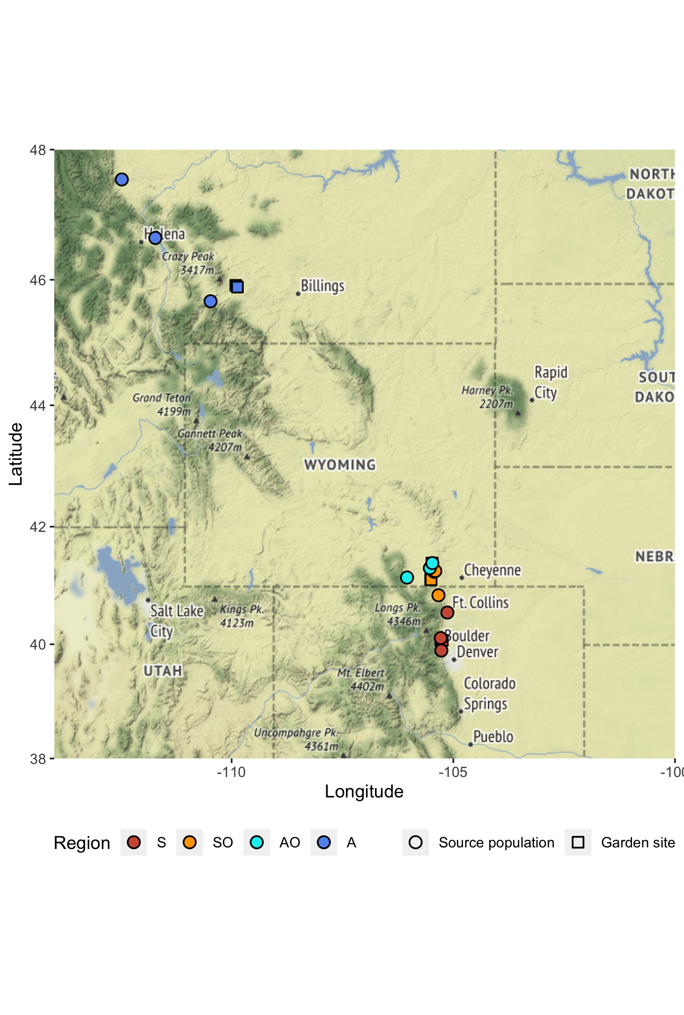
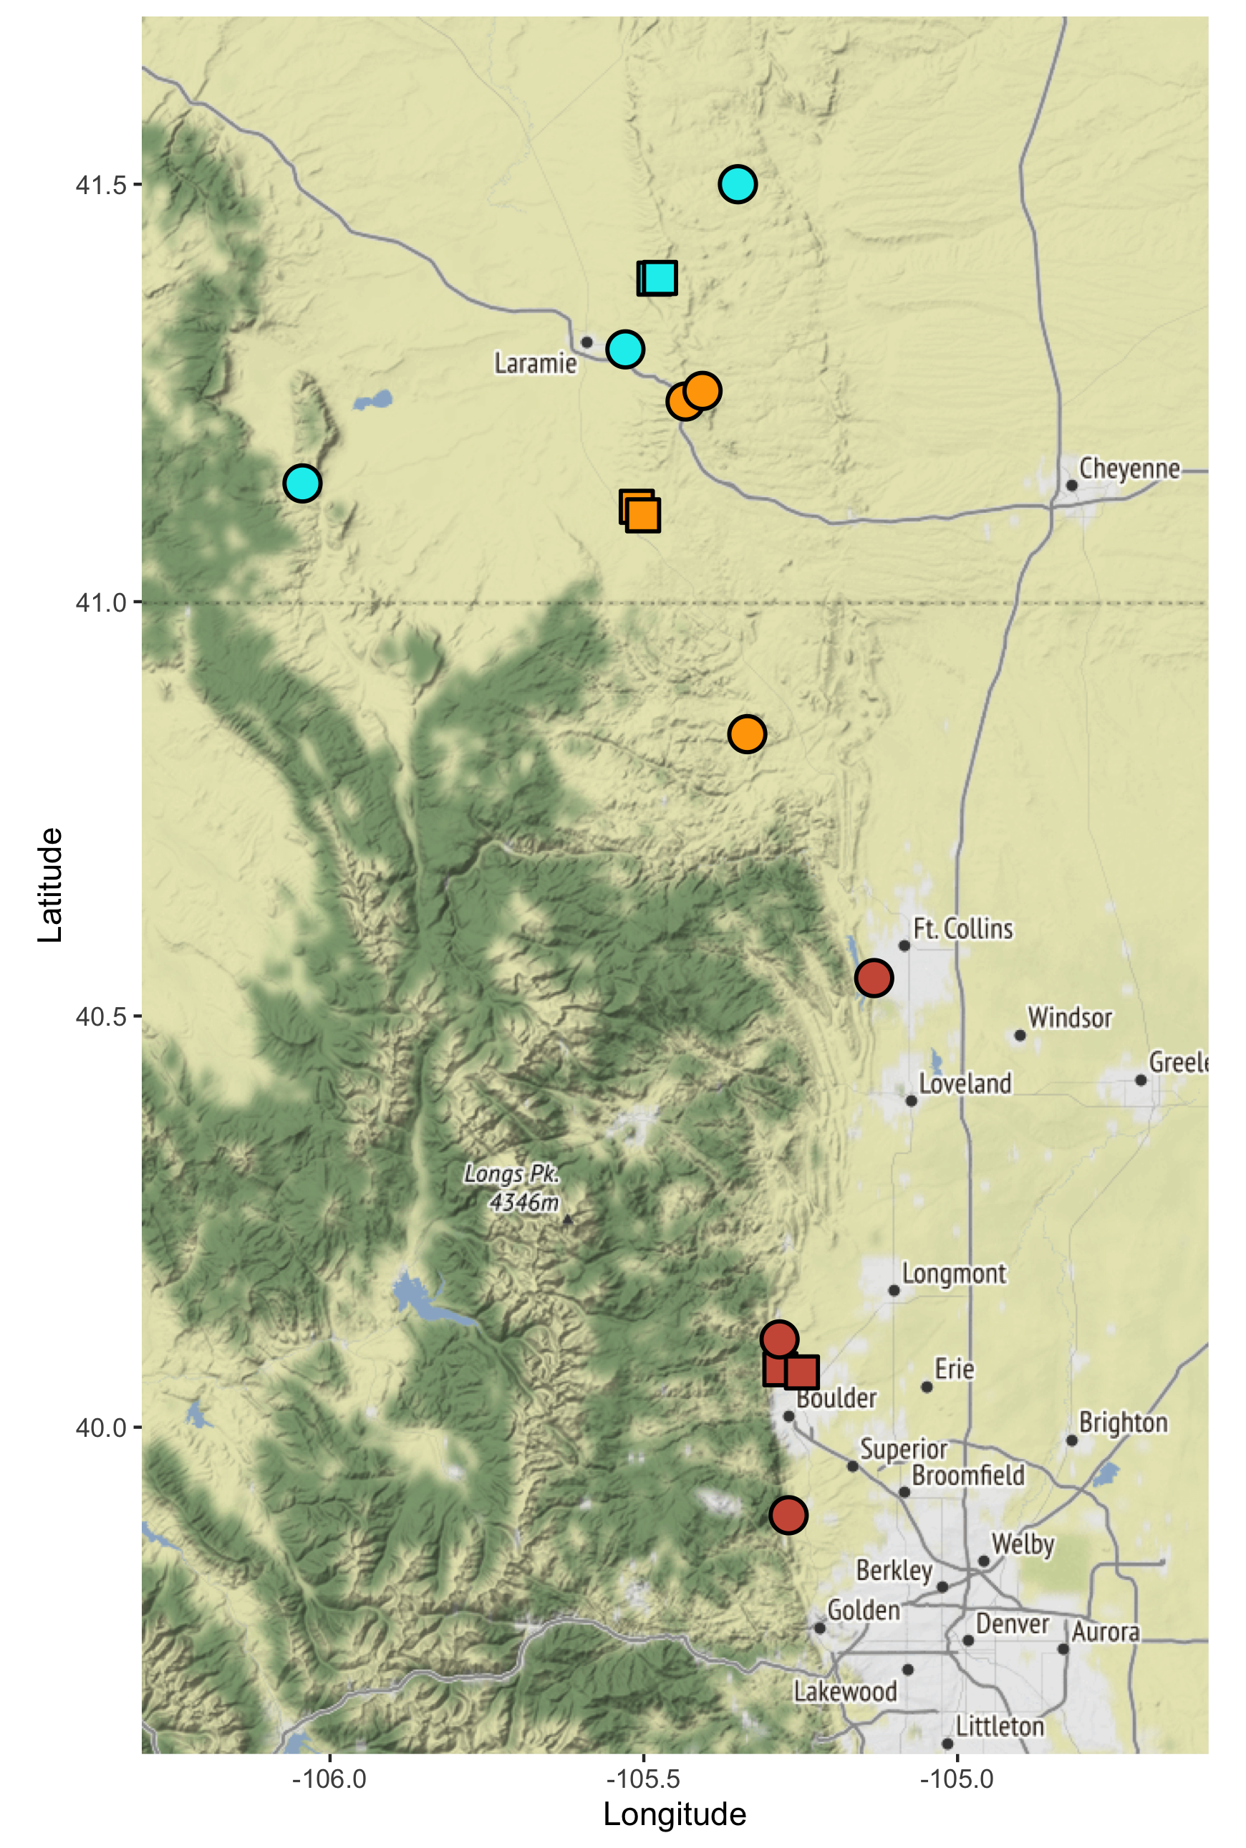
C27
L17
C85
AO_{g}
A_{g}
L16
L12
C86
L06
L11
SO_{g}
B49
B46
B42
S_{g}
B53

